Slide 1
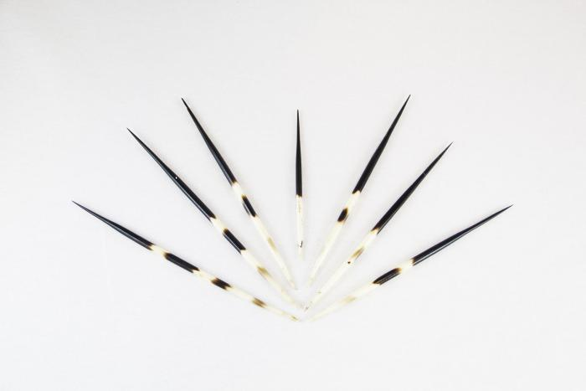
7 Porcupine Quills (MU3499)

Slide 2
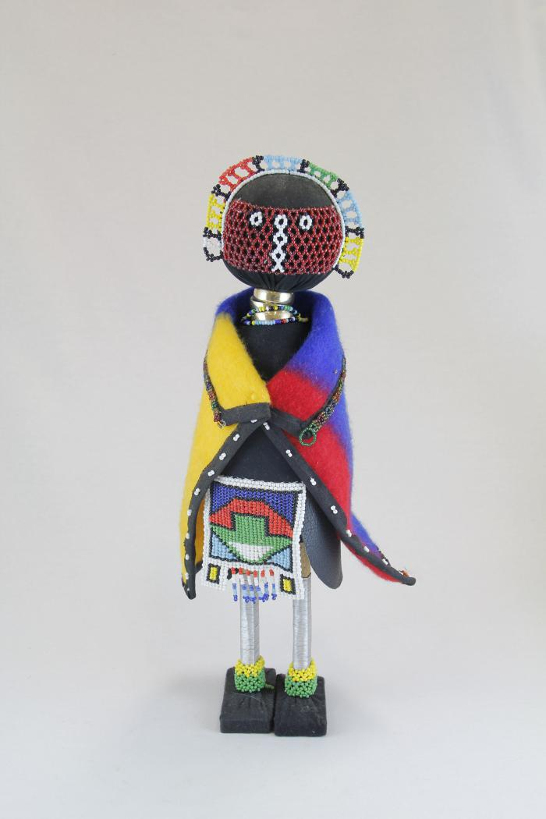
Initiation Doll (MU1)

Slide 3
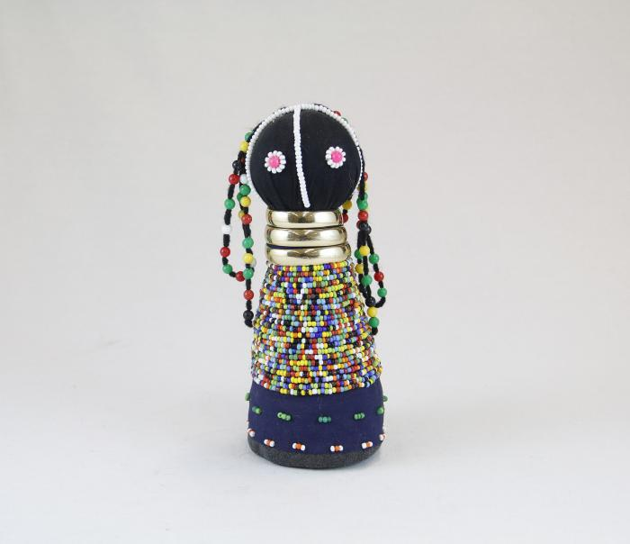
Sangoma Doll (MU2)

Slide 4
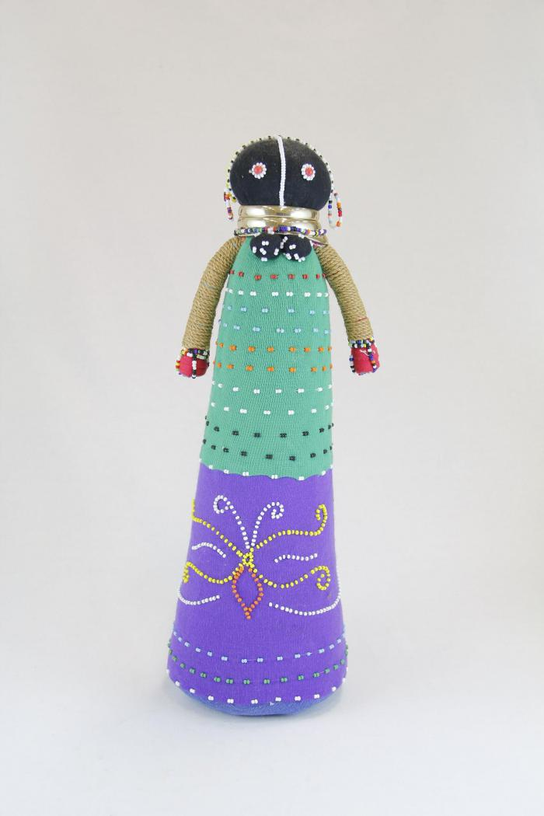
Ceremonial Doll (MU3)

Slide 5
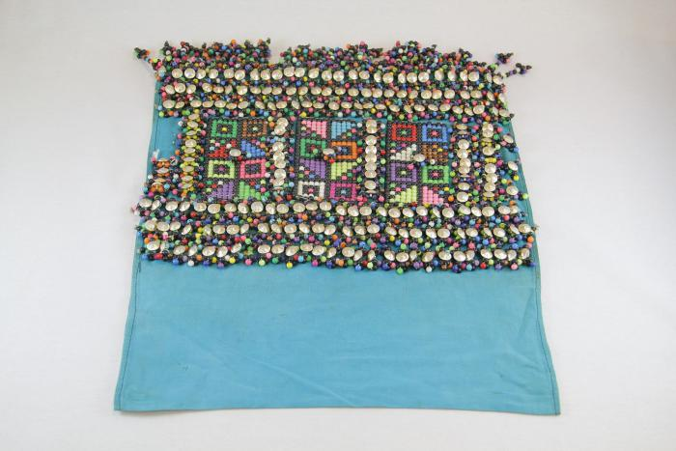
Isicwoyo Front Apron (MU4)

Slide 6
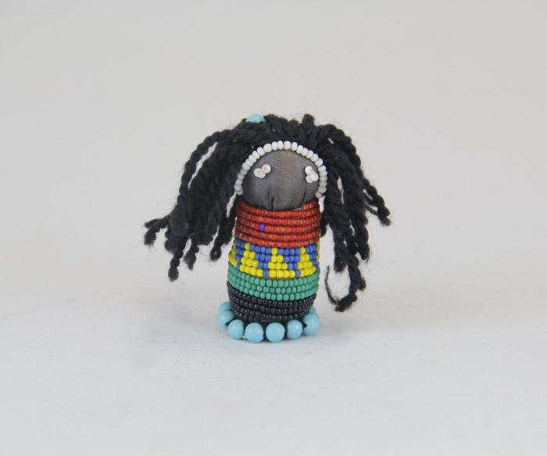
Small Doll (MU5)

Slide 7
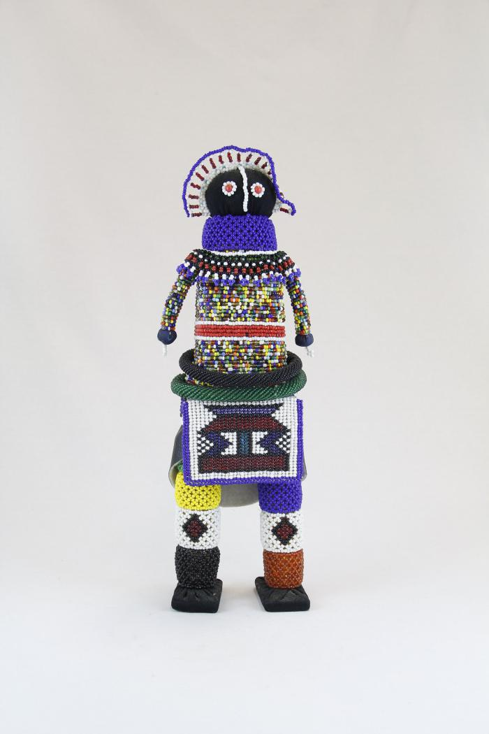
Maiden Doll (MU6)

Slide 8
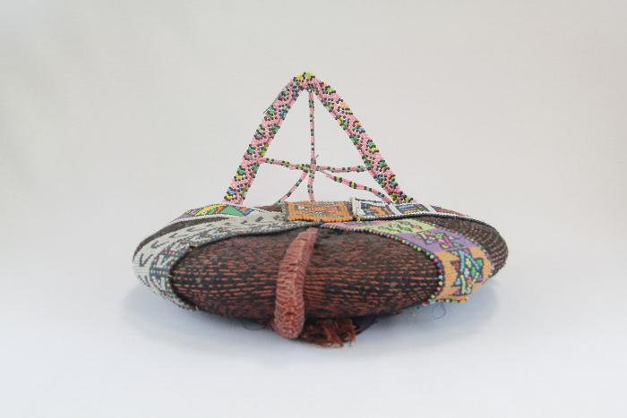
Inkehli / Headdress (MU7)

Slide 9
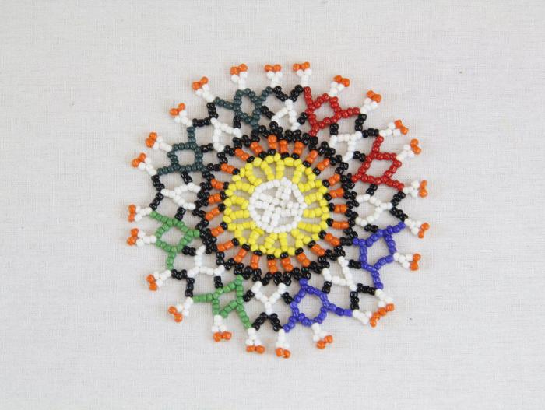
4 Beaded Coasters (MU11)

Slide 10
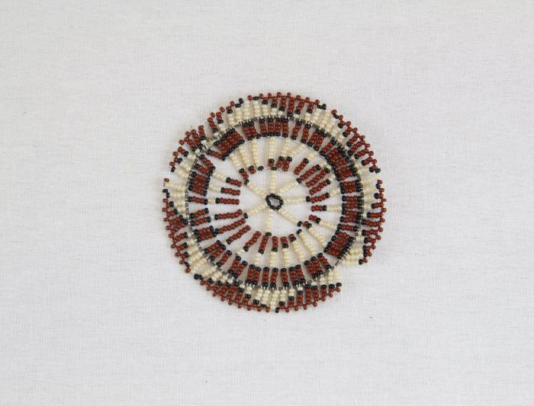
Brown, Black and White Coaster (MU12)

Slide 11
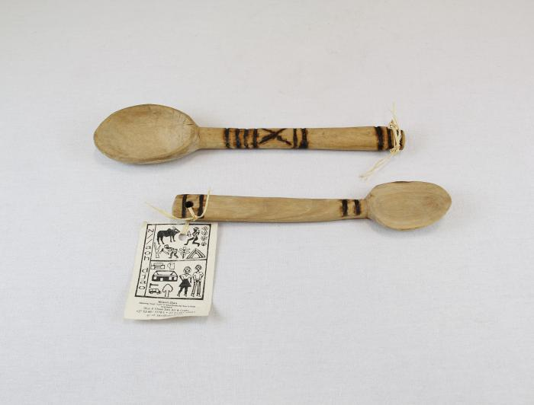
Two Wooden Spoons (MU19)

Slide 12
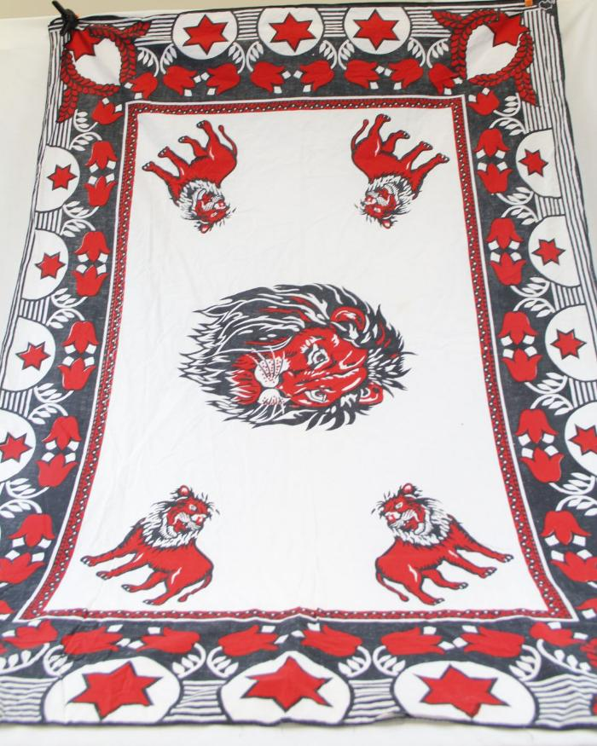
Mapula (Mother of Rain) Flower and Lion Cloth (MC17)

Slide 13
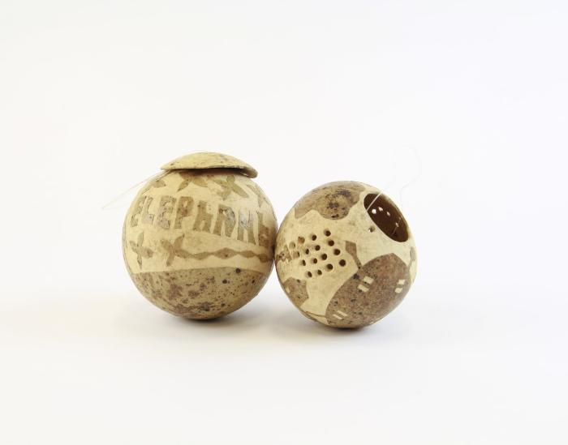
"Elephant" Carved Dried Gourd with Lid (YO1)

Slide 14
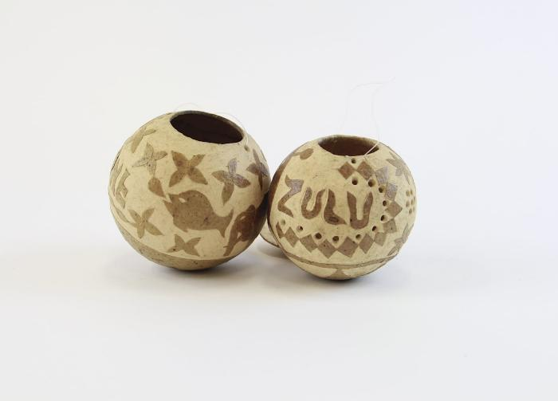
"Zulu" Carved Dried Gourd (YO2)

Slide 15
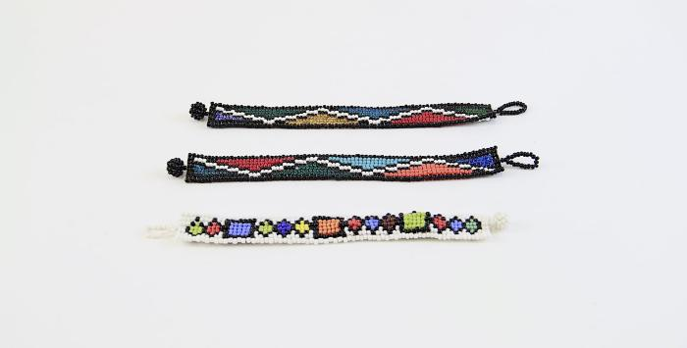
Beaded Bracelets (YO3)

Slide 16
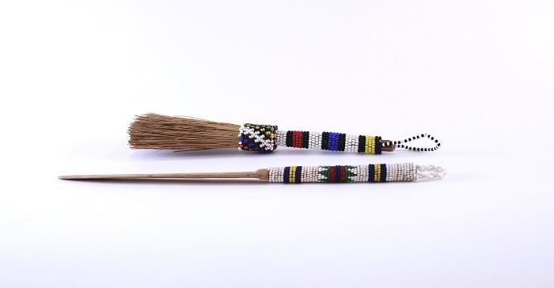
Beaded Wood Ndebele Brush (YO4)

Slide 17
Beaded Wood Ndebele Knife (YO5)

Slide 18
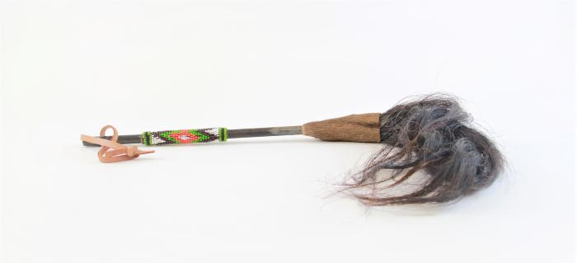
Beaded Fly Whisk (YO8)

