Slide 1
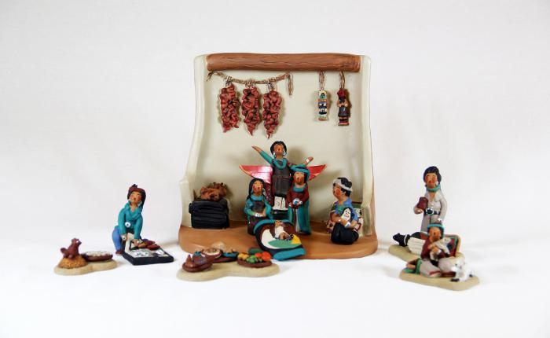
Native American Nativity (13 pieces) (M1068)

Slide 2
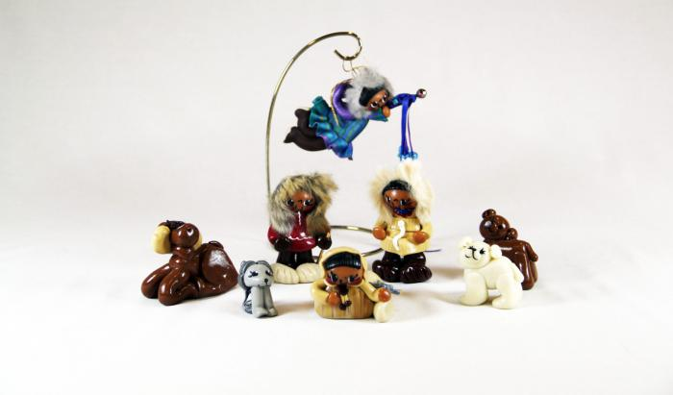
Eskimo Nativity (14 pieces) (M1096)

Slide 3
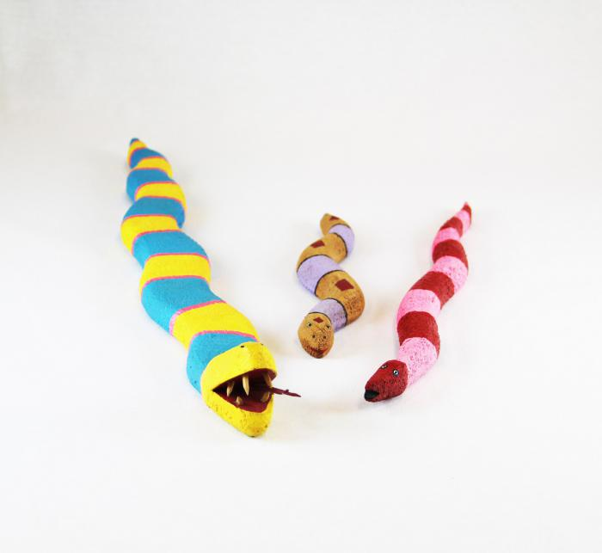
3 Native American Fantasy Snakes (MU3472)

Slide 4
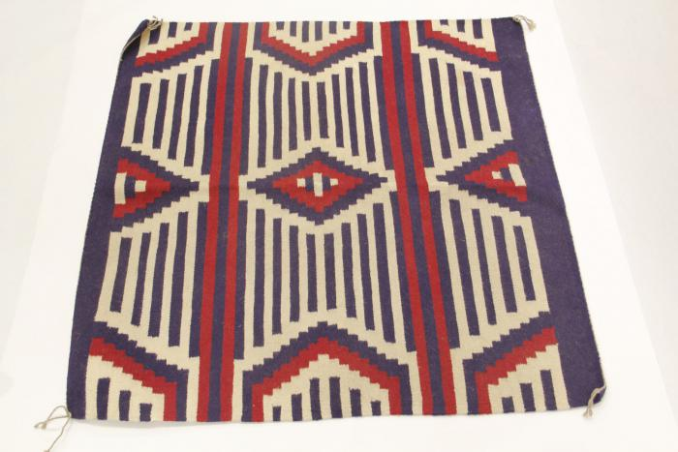
Red, White & Blue Woven Wool Rug (MU3473)

Slide 5
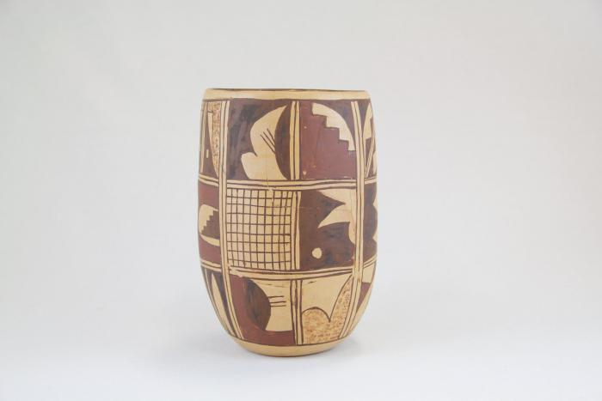
Zuni Burnished Pot (Cracked & Repaired) (MU3479)

Slide 6
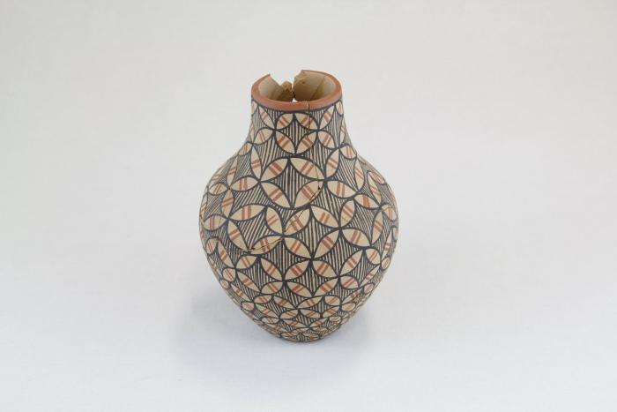
Zuni Terra Cotta Pot with Brown & Red Accents (MU3480)

Slide 7
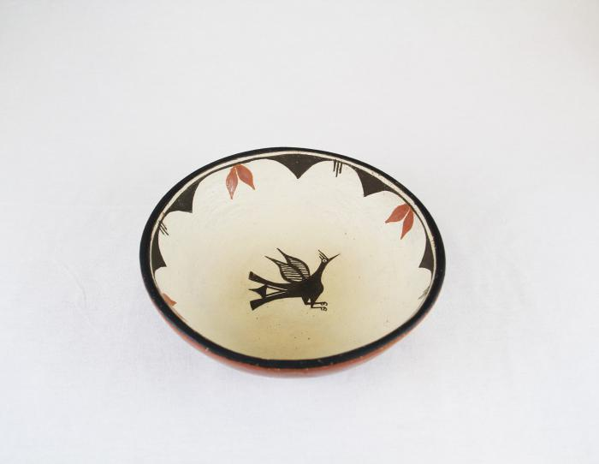
Terra Cotta Bowl with Bird in Center (MU3483)

Slide 8
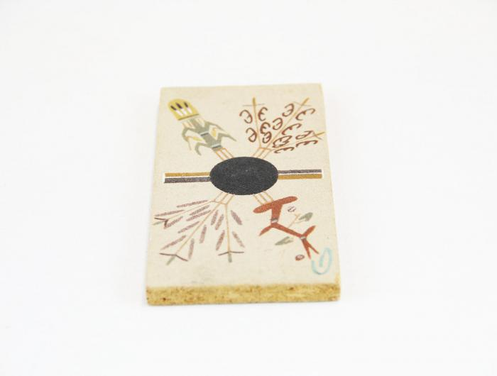
Painted Particle Board (MU3484)

Slide 9
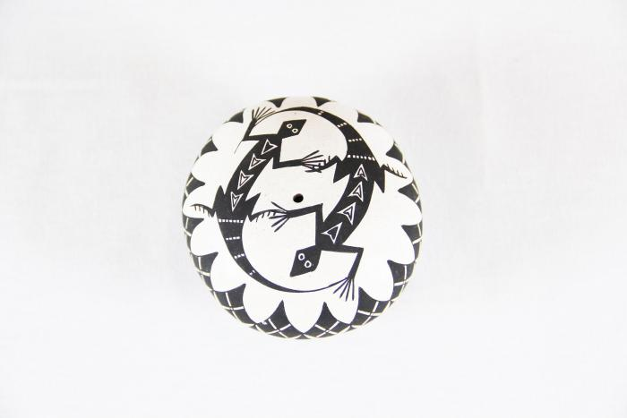
Black & White Seed Pot with lizards (MU3485)

Slide 10
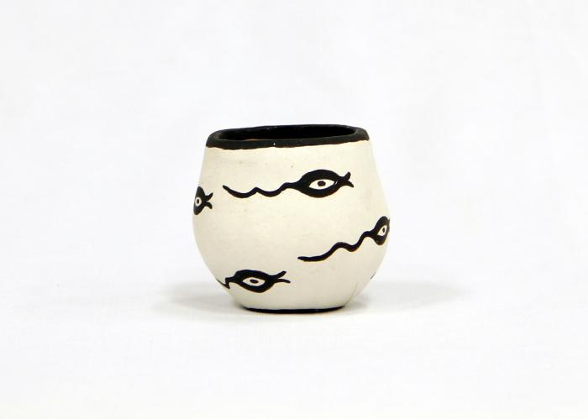
Black & White Zuni Pot with Tadpole Motif (MU3486)

Slide 11
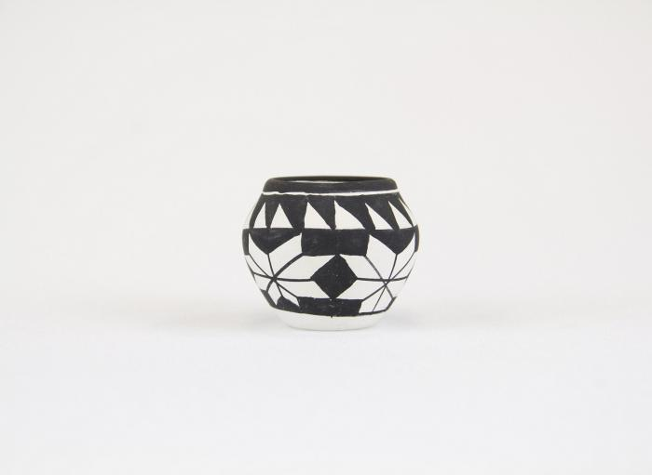
Clay Black & White Acoma Pot (MU3487)

Slide 12
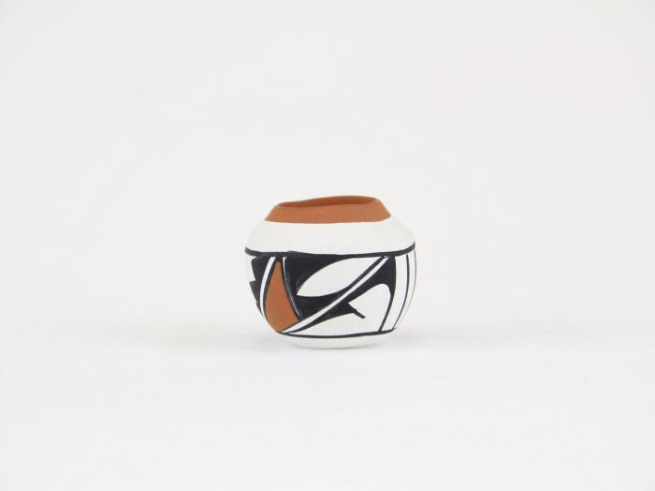
Small Clay White, Black & Tan Painted Pot (MU3488)

Slide 13
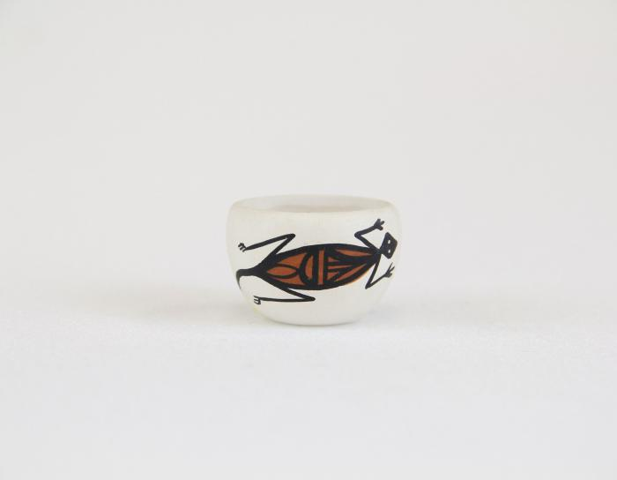
Small Painted Acoma Pot with Lizard Design (MU3489)

Slide 14
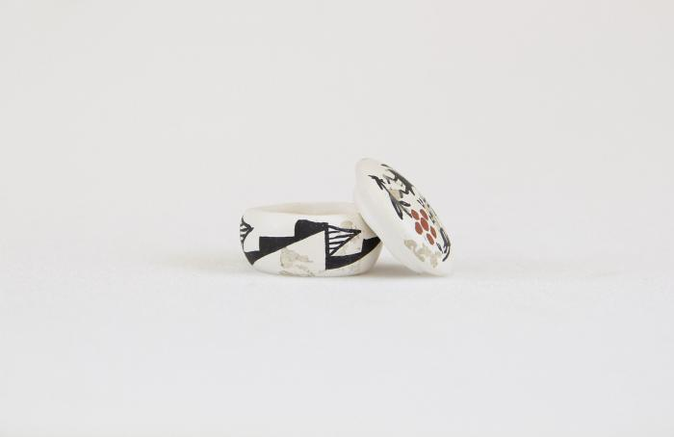
Small painted Acoma Pot with Lid & Kokopelli design (MU3490)

Slide 15
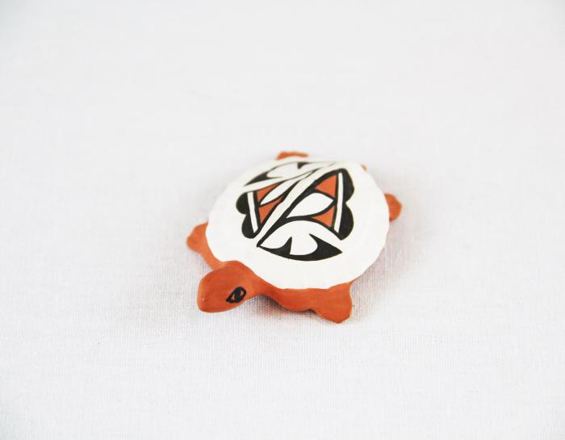
Small Painted Clay Turtle (MU3491)

Slide 16
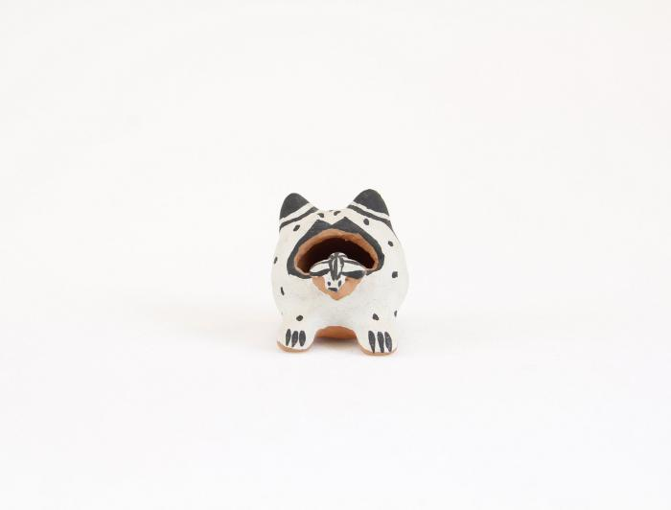
Cochiti Pueblo Ceramic Frog (MU3492)

Slide 17
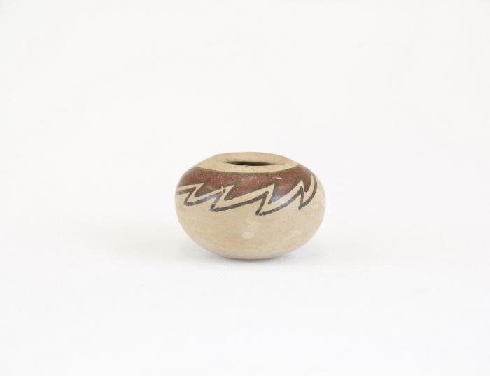
Small Clay Brown and Tan Painted Pot (MU3493)

Slide 18
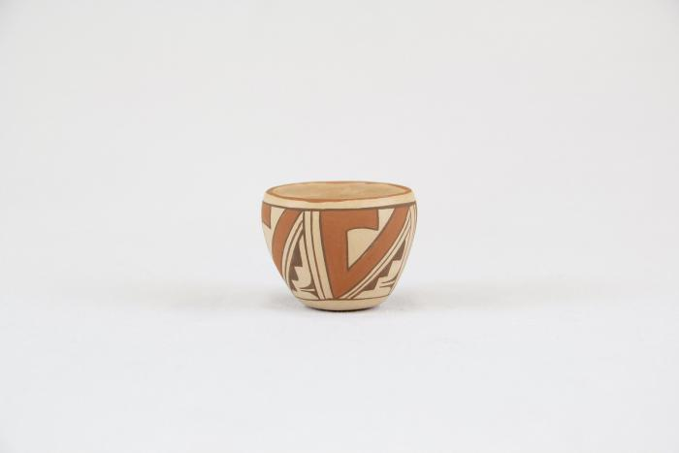
Small Clay Painted Pot (MU3494)

Slide 19
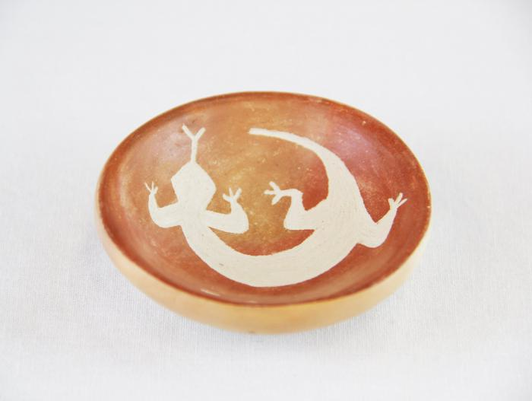
Small Clay Brown & Tan Painted Incense Burner with Lizard Design (MU3495)

Slide 20
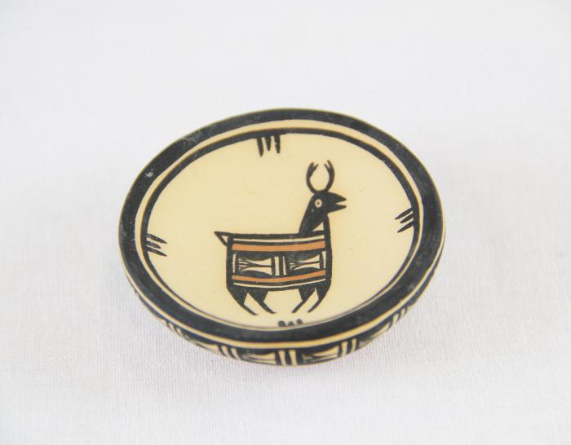
Small Clay Black & White Painted Bowl with Deer Design (MU3496)

Slide 21
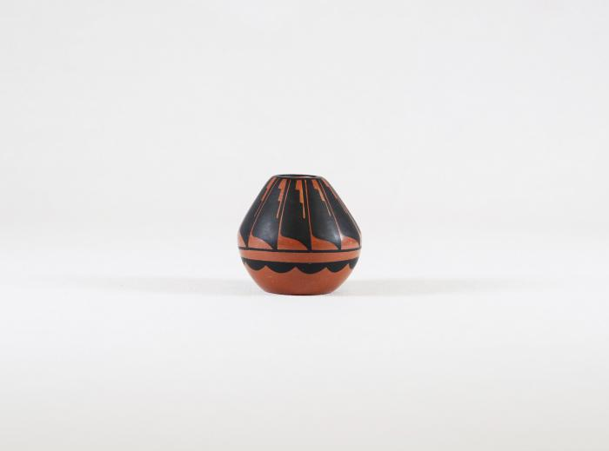
Small Painted Brown & Black Ceramic Pot (MU3498)

Slide 22
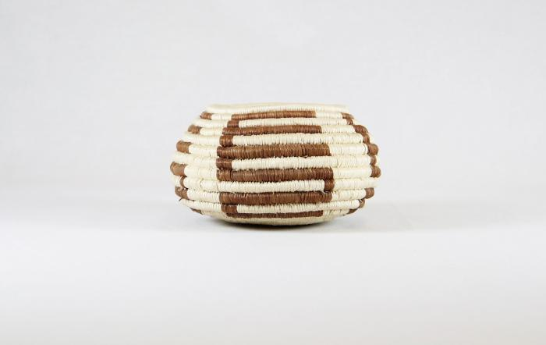
Tohona-O’Odham Small Woven Cream & Brown Coil Pot (MU3500)

Slide 23
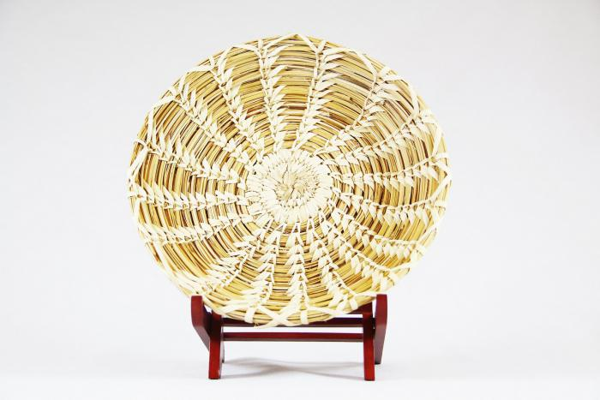
Tohona-O’Odham Yucca & Devil Claw Round Basket with Rim (MU3501)

Slide 24
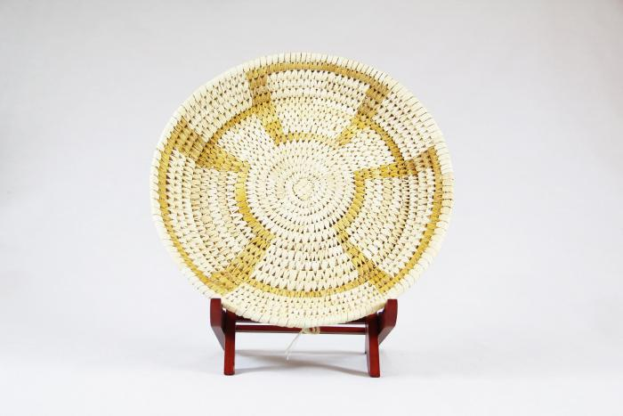
Tohono-O’Odham Woven Yucca Round Basket (MU3502)

Slide 25
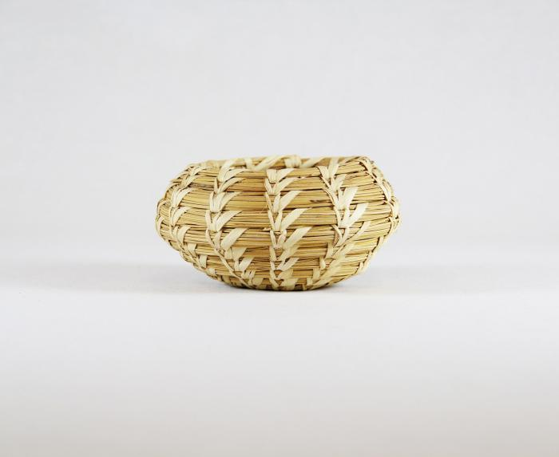
Tohono-O’Odham Woven Yucca Basket (MU3503)

Slide 26
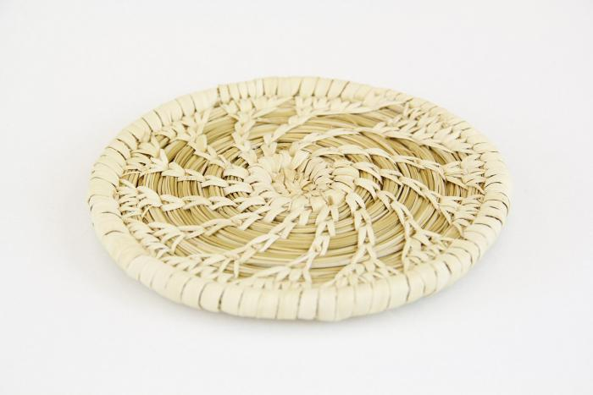
Tohono-O’Odham Flat, Round Basket with Yucca Flower Pattern (MU3504)

Slide 27
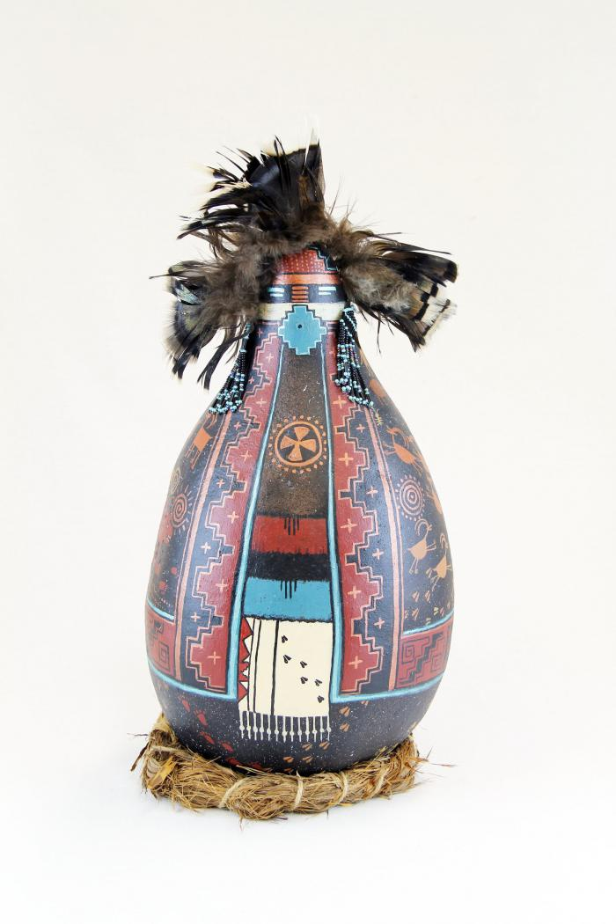
Gourd Doll on Grass Ring Pedestal (MU3506)

Slide 28
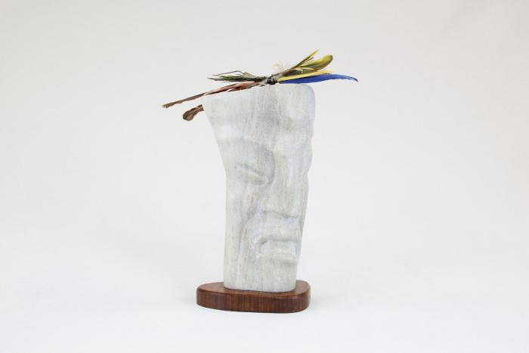
Singer Stone Figure Sculpture with Bird Feathers (MU3507)

Slide 29
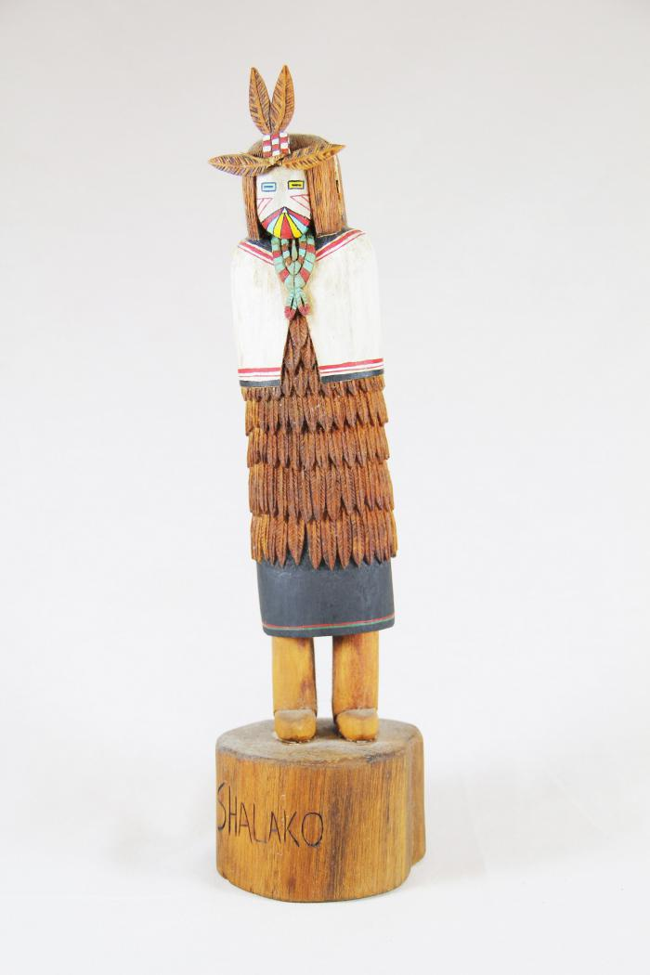
Kachina Doll (Shaloko) (MU3508)

Slide 30
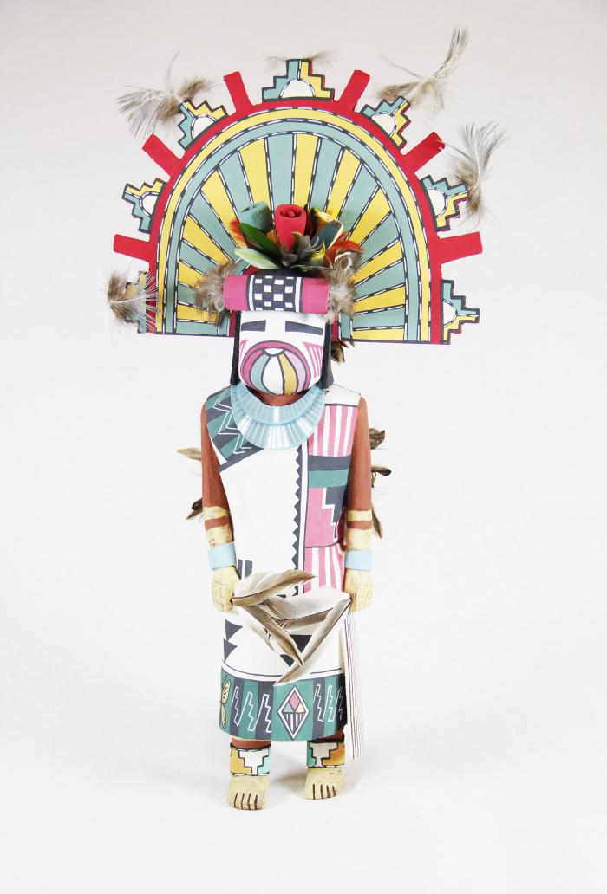
Kachina Doll (Palhik Mana) (MU3509)

Slide 31
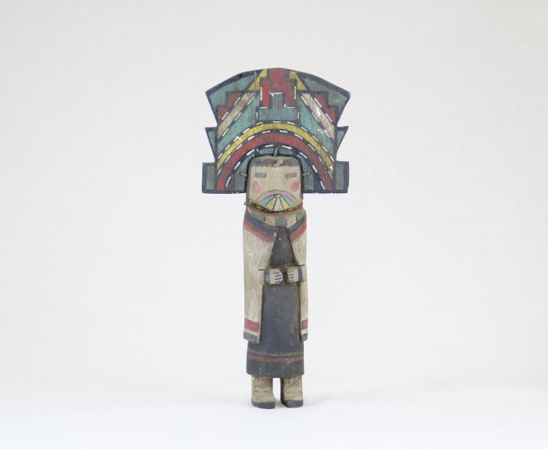
Kachina Doll (MU3510)

Slide 32
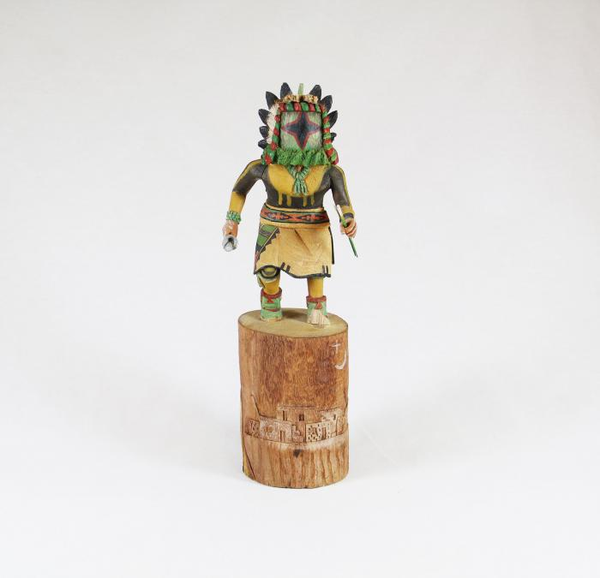
Kachina Doll (Chasing Star) (MU3511)

Slide 33
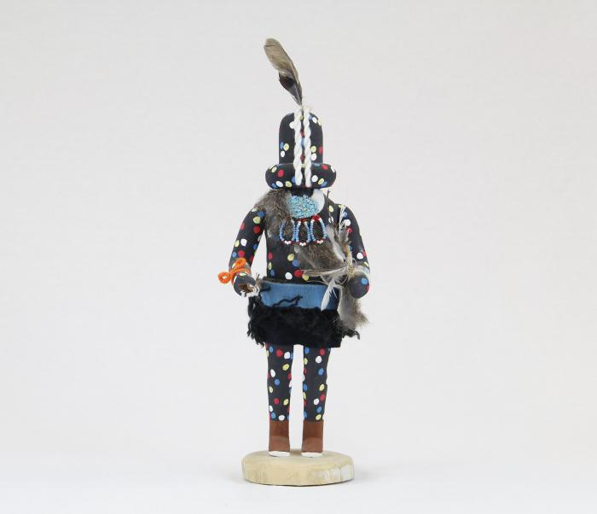
Kachina Doll (Zuni Fire God) (MU3512)

Slide 34
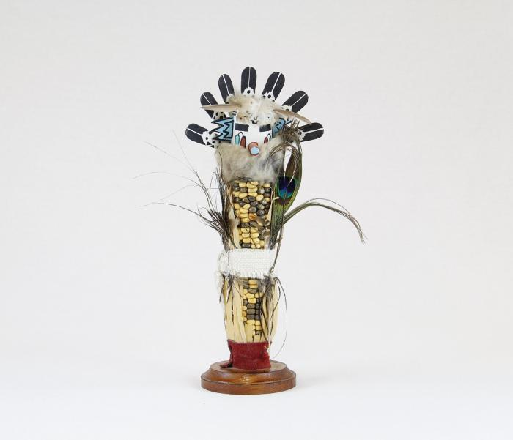
Kachina Doll (Corn Maiden) (MU3513)

Slide 35
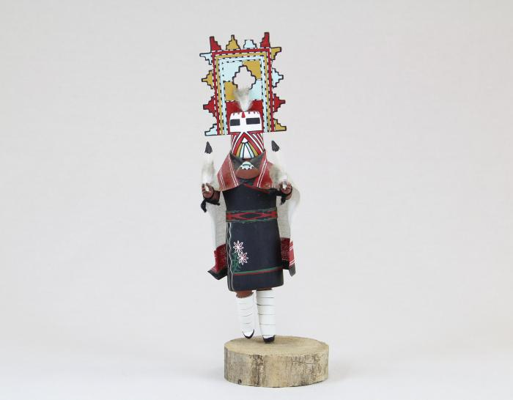
Kachina Doll (Palhik Mana) (MU3515)

Slide 36
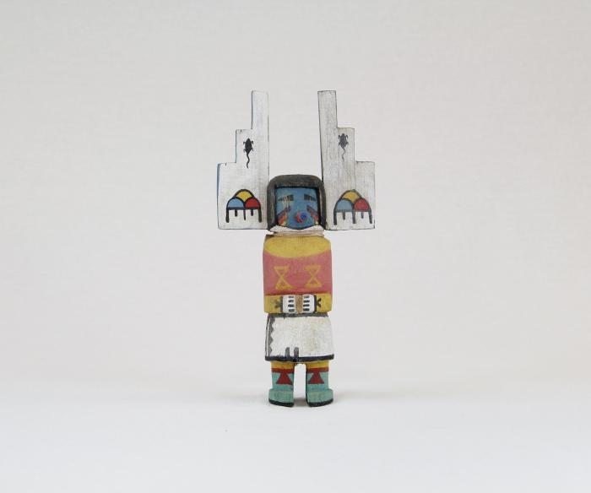
Kachina Doll (MU3516)

Slide 37
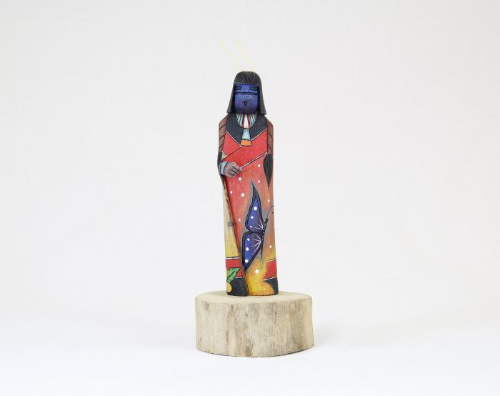
Kachina Doll (Shalako) (MU3517)

Slide 38
Kachina Doll (Ogre Woman) (MU3518)

Slide 39
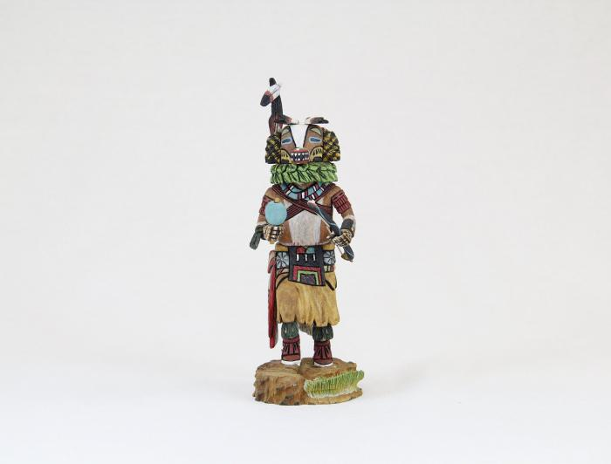
Kachina Doll (Badger) (MU3519)

Slide 40
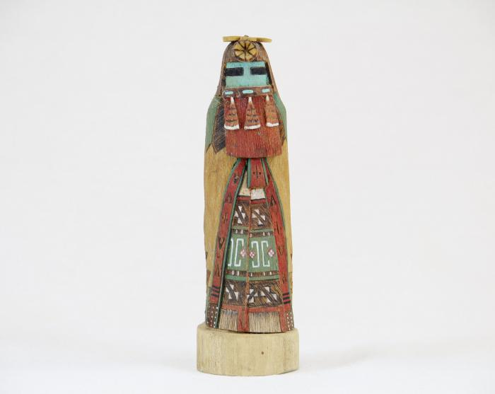
Kachina Doll (Hopi - Red Beard Long Hair) (MU3520)

Slide 41
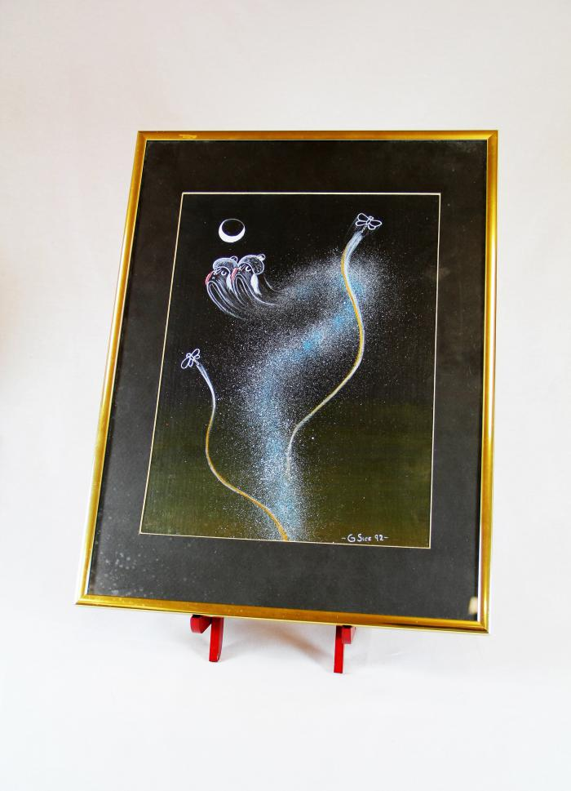
"4th World" Painting (MU3523)

Slide 42
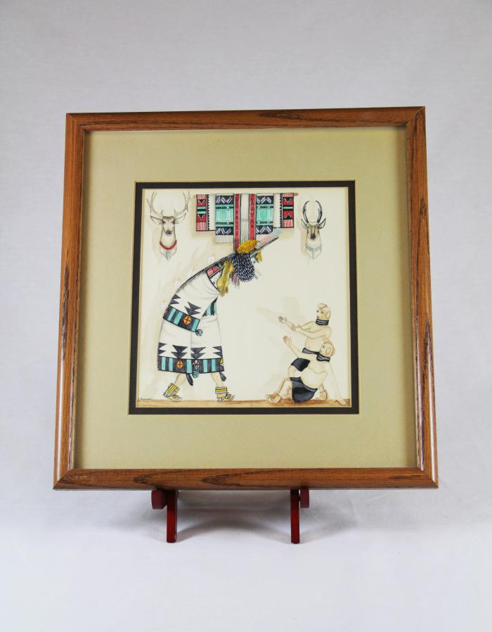
Zuni Shalako Kachina Painting (MU3525)

Slide 43
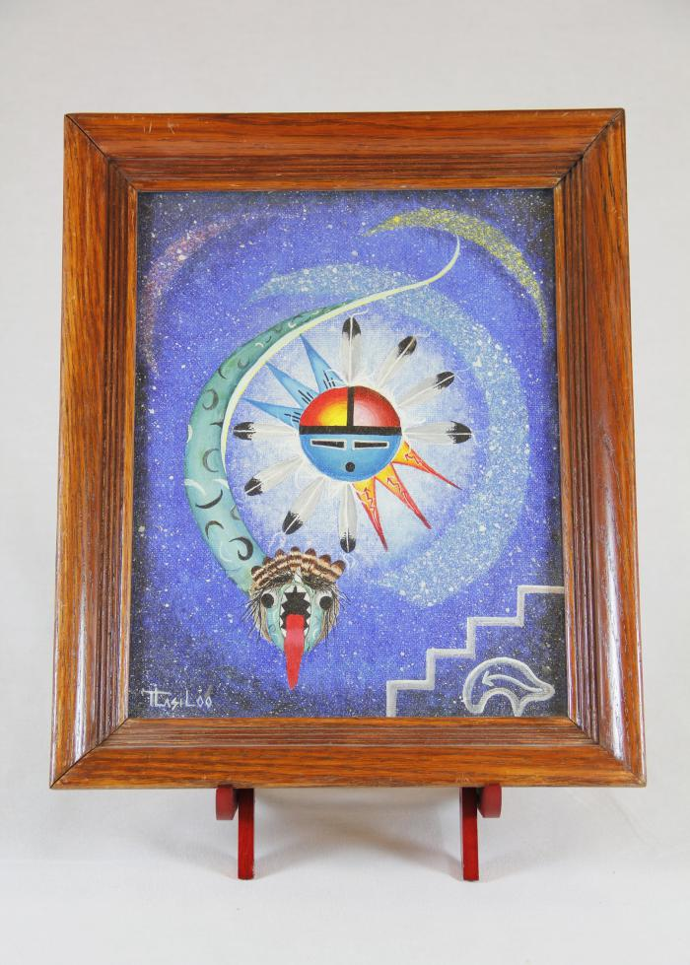
Sun Father and Snake Painting (MU3526)

Slide 44
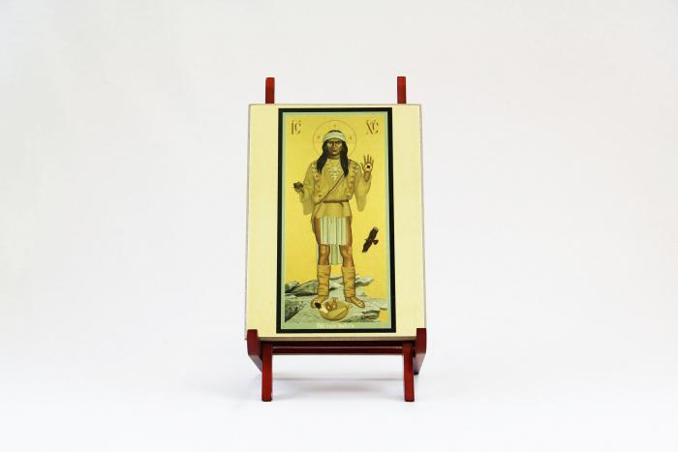
Apache Christ (MU3527)

Slide 45
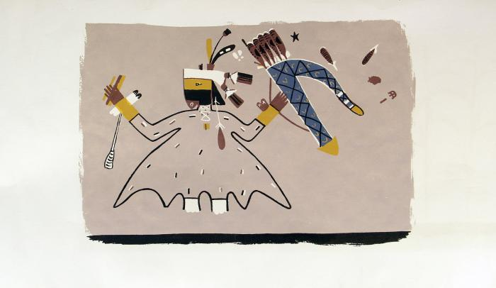
Paper scroll with rendering of mural on the interior walls of a painted kiva in the Southwest area (MU3528)

Slide 46
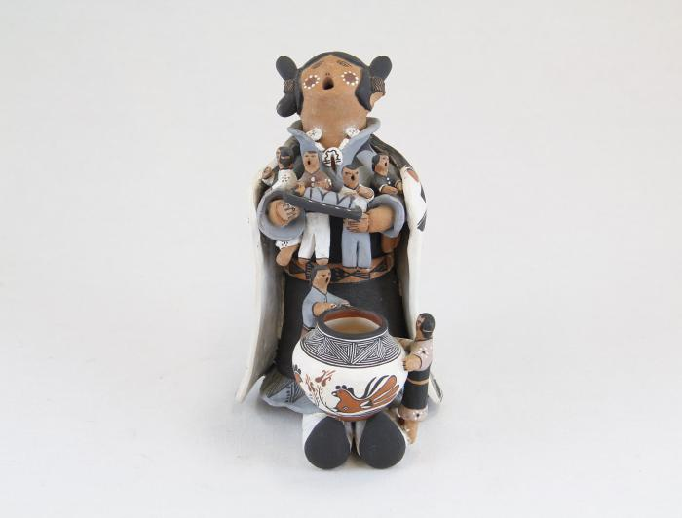
Storytelling Woman, "Naya" (MU13)

Slide 47
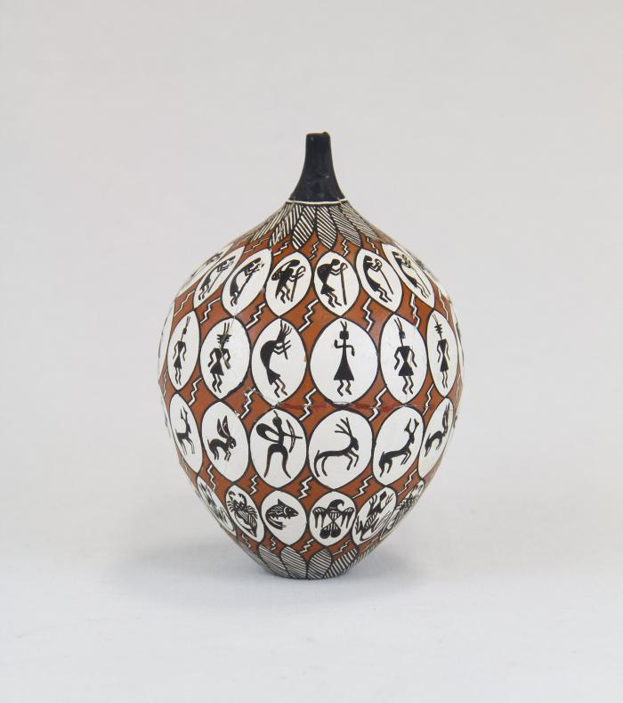
Storytelling Painted Clay Pot (MU14)

Slide 48
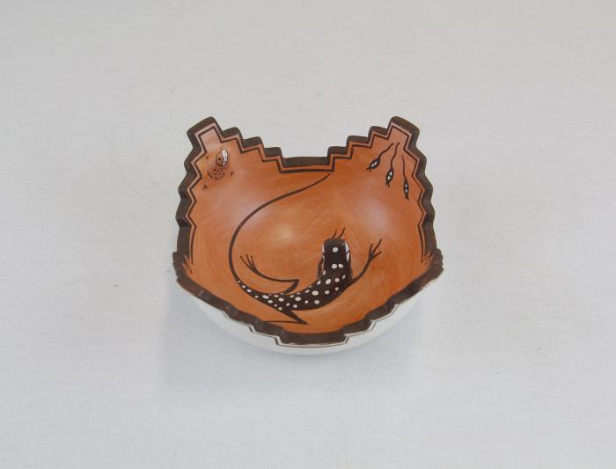
Zuni Pot with Lizard in Center (MU15)

Slide 49
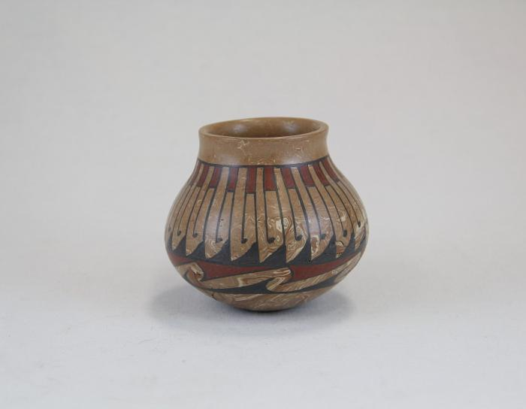
Repeated Wave Pot (MU16)

Slide 50
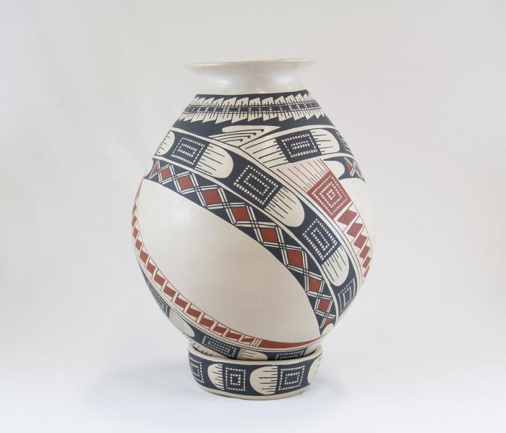
Jar with belt pattern and base (MU17)

Slide 51
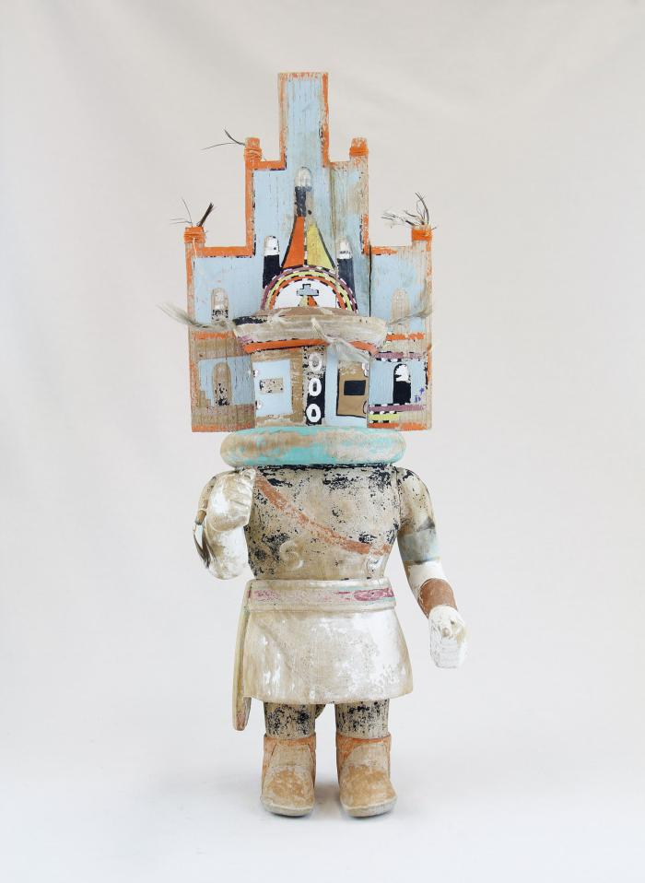
Hopi Hemis Kachina (MU18)

Slide 52

Kachina doll (Hilili) (MU3514)

Slide 53

Kachina Doll (Handprint Racer) (MU3521)

Slide 54

Oil Painting of Kachina Figure Framed in Wood (MU3524)

Slide 55

Face Jug (EH4)

Slide 56

Three Minstrels (EH10)

Slide 57

Jumex Ceramic Heart with Nails (EH16)

Slide 58

Wolf Head on Metal Band (EH17)

Slide 59

"Sisters in Progress", Painted Rock Paperweight (EH19)

Slide 60

Woman Riding Elephant in Glass Case (EH20)

Slide 61

George Washington (EH21)

Slide 62

Woman Guitarist (EH23)

Slide 63

Three Sitting Dogs Playing Cards on Green Plank (EH25)

Slide 64

Cowboy Alligator (EH26)

Slide 65

Two Carved Wood Indoor Scenes (EH29)

Slide 66
Howard Finster Eagle and Poem on Board (EH30)

Slide 67

Woman and Child (EH32)

Slide 68

Polar bear with Cub (AC1)

Slide 69

Boy Fishing (AC2)

Slide 70

Humpback whale (AC3)

Slide 71

Spirit of the Mountain (AC4)

Slide 72

Two-Headed Statue (AC5)

Slide 73

Caribou Skin Mask with Black Ink Tattoos (AC6)

Slide 74

Stages of Marriage Bracelet (AC7)

Slide 75

Eagle and Fish (AC8)

Slide 76

Miniature Mountain Spirit Mask (AC9)

Slide 77

Loon Birds Earrings (AC10)

Slide 78

Kayak Necklace (AC11)

Slide 79

Ivory Swan Pendant (AC12)

Slide 80

Lucky Halibut (AC13)

Slide 81

Round Earrings (AC14)

Slide 82

Rhombus Earrings (AC15)

Slide 83

Beluga Whale (AC16)

Slide 84

Baby Seal (AC17)

Slide 85

Baby Polar Bear (AC18)

Slide 86

Bird Pendant (AC19)

Slide 87

Button Face Native Doll (AC20)

Slide 88

Yupik Bone Doll (AC21)

Slide 89

Yupik Bone Doll (AC22)

Slide 90

Chevak Cup'ik Doll holding Berries (AC23)

Slide 91

Chevak Cup'ik Doll (AC24)

Slide 92

"Land Carer" (PE1)

Slide 93

"Mother Earth" (PE2)

Slide 94

Bird House and Flowers (HA1)

Slide 95

Man smoking pipe with cat and flowers (HA2)

Slide 96

Two girls and chickens (HA3)

Slide 97

Cat sits on chair surrounded by flowers (HA4)

Slide 98

Catrina (ME1)

Slide 99

Vollis Simpson Whirligig (HN1)

Slide 100

Three Figures (DA1)

Slide 101

Pima Coil Basket (FR152)

Slide 102

Robert Rivera Gourd with Flute Player (FR153)

Slide 103

Amish Dolls (FR154)

